Slide 1

Operation Analytics and Investigating Metric Spike
Sumeet Dutta

Slide 2
Table Of Content
Project Description
Insights
Objectives
Tech-Stack Used
Approach

Slide 3

PROJECT DESCRIPTION
In this project, as the lead Data Analyst, I have derived various insights from the dataset provided to me by different departments within the company.
To derive those insights I have used advance SQL skills and basic mathematics.

Slide 4
Objectives
Calculate the number of jobs reviewed per hour for each day in November 2020.
Calculate the 7-day rolling average of throughput (number of events per second).
Calculate the percentage share of each language in the last 30 days.
Identify duplicate rows in the data.
Measure the activeness of users on a weekly basis.
Analyse the growth of users over time for a product.
Analyse the retention of users on a weekly basis after signing up for a product.
Measure the activeness of users on a weekly basis per device.
Analyse how users are engaging with the email service.

Slide 5



Approach
I have used relational database software to derive insights to answer the question that various departments imposed to the best of my abilities

Slide 6

Tech-Stack
For this project the tech stack used includes MySQL Workbench version 8.0.38, which is the latest version of MySQL Workbench and although it is an open source software, which sometimes contains bugs but thanks to MySQL large community that problem is non-existent, it is an outstanding tool for executing queries related to database.

Slide 7
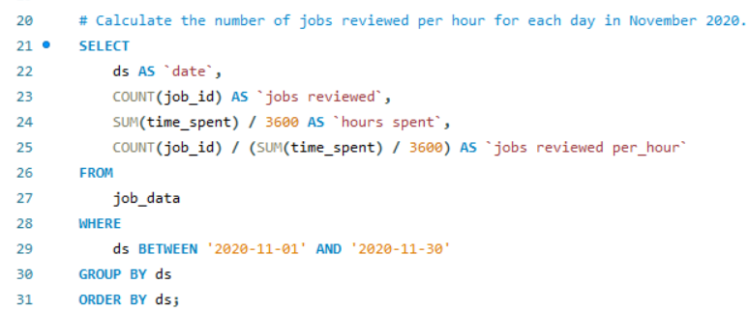
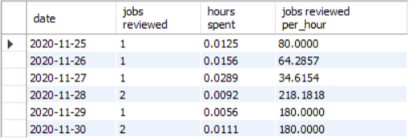
Insights (Case Study 1)
Query : Calculate the number of jobs reviewed per hour for each day in November 2020.
Finding : In the given dataset, the highest number of jobs reviewed is in the 28th November, 2020 which is 218.

Slide 8
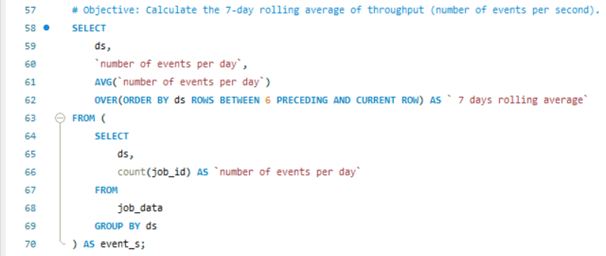
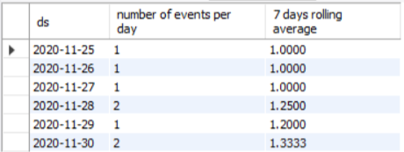
Insights (Case Study 1)
Query : Calculate the 7-day rolling average of throughput
Finding : Since the difference between events happening per day and the throughput is not big so I prefer the 7-day rolling average for throughput because it provides a clearer picture of overall performance trend, making it more useful for long-term monitoring and decision-making.

Slide 9
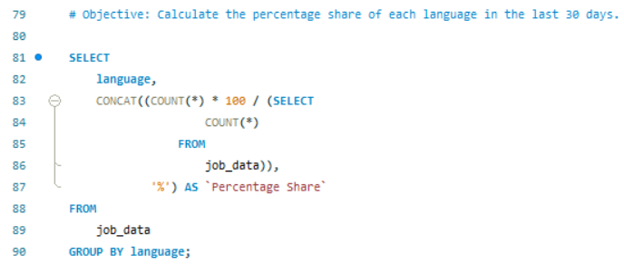
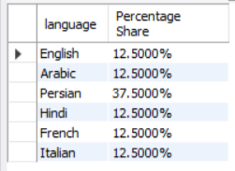
Insights (Case Study 1)
Query : Calculate the percentage share of each language in the last 30 days.
Findings : Highest percentage share of the languages is 37.5% which is taken by Persian.

Slide 10
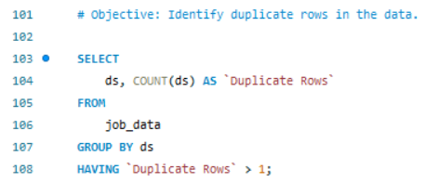

Insights (Case Study 1)
Objectives : Identify duplicate rows in the data.
Findings : There are two duplicate rows in the entire table which are present in 28th and 30th November, 2020

Slide 11
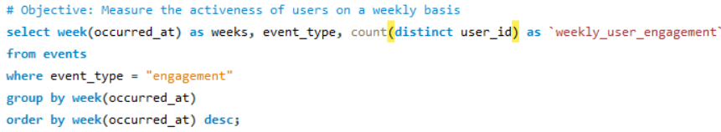
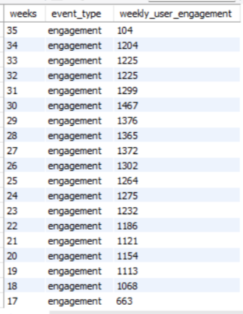
Insights (Case Study 2)
Objectives : Measure the activeness of users on a weekly basis.
Findings : 35th week holds the lowest user engagement whereas the 30th week holds the highest user engagement.

Slide 12
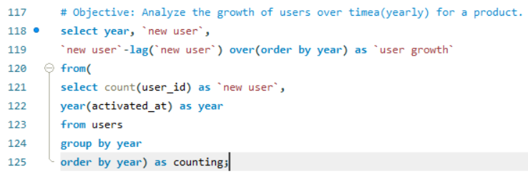

Insights (Case Study 2 Part 1)
Objectives : Analyse the growth of users over time(yearly) for a product.
Findings : In 2014, the total number of users increased to 6098, which was 3283 in 2013. It means that 2815 new users were added in 2014.

Slide 13
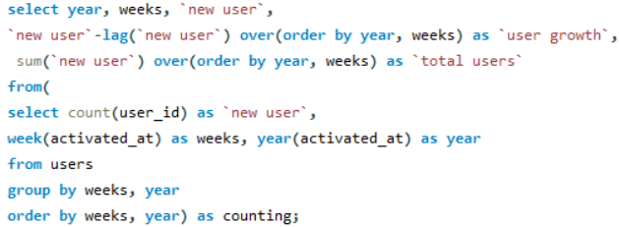
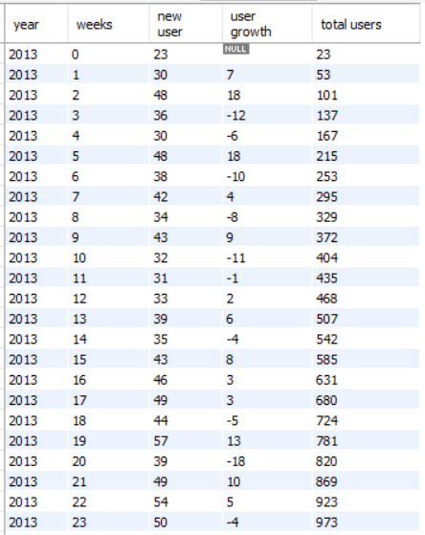
Insights (Case Study 2 Part 2)
Objectives : Analyse the growth of users over time(weekly) for a product.
Findings : The highest user growth in 2013 was in 42nd week and 32nd week in 2014. There is a sharp drop in user growth on 52nd week of 2013 and 35th week of 2014.

Slide 14
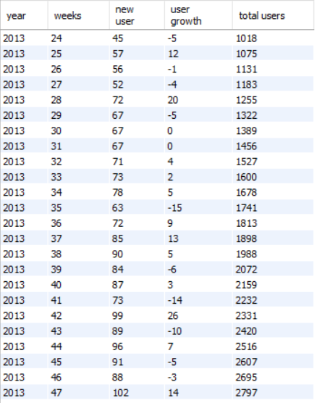
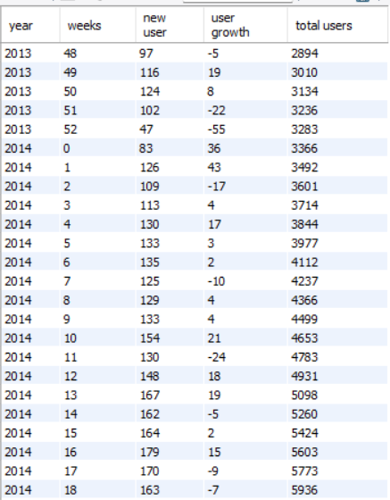
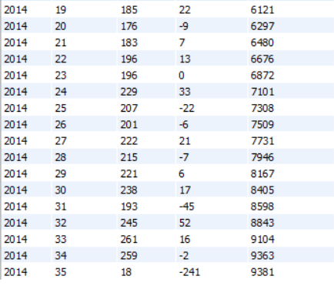

Slide 15
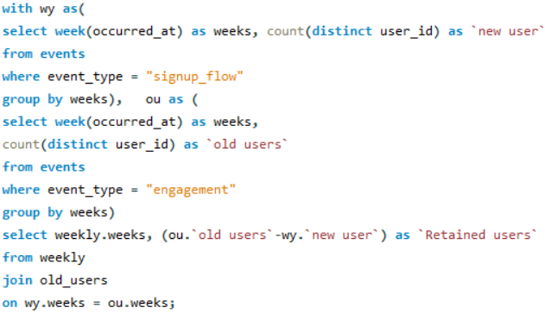
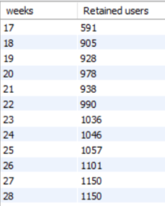
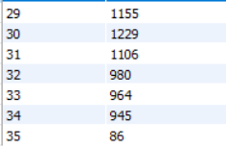
Insights (Case Study 2)
Objectives : Analyse the retention of users on a weekly basis after signing up for a product.
Findings : 30th week has the highest number of retained users and 35th week has the lowest number of retained users.

Slide 16
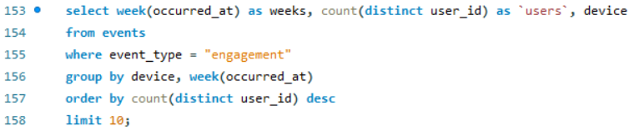
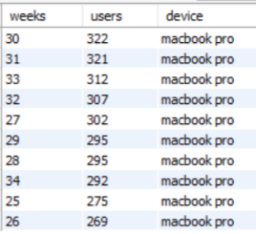
Insights (Case Study 2)
Objective : Measure the activeness of users on a weekly basis per device.
Findings : MacBook pro has the highest number of active users.

Slide 17
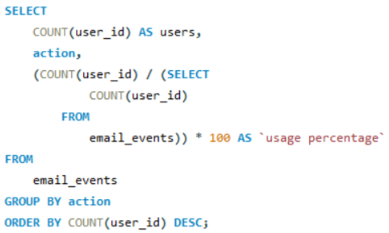
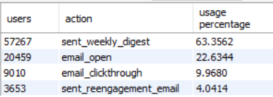
Insights (Case Study 2)
Objective : Analyse how users are engaging with the email service.
Finding : Weekly digest has the highest percentage of engagement with over 60% of user engaging in the weekly digest.

Slide 18


